Slide 1


High(er) Security Firefox Accounts
Sai Prashanth Chandramouli
Cloud Services Team
irc: saipc
Github: TDA
E-mail: thatsenough@youstalker.com

Slide 2
Disclaimer
All details on these slides are purely fictitious based on fact.
No Animals were harmed in the making of this slideshow (unless you count me).
I make obscure references to filmography and some computer fields. Ask if it is unclear.
All photos/images used here were taken from(sometimes of) free-to-get sources like xkcd, and my team mates ( jgruen and pdehaan). Any copyright infringement claim will fall flat on its face, so don’t even think about it.
Any references, messages, images bearing resemblance to any real life object, person or animal were probably NOT coincidental, and any that are found to be offensive were probably meant to be offensive.
So quit whining and let’s move on to the next slide.

Slide 3
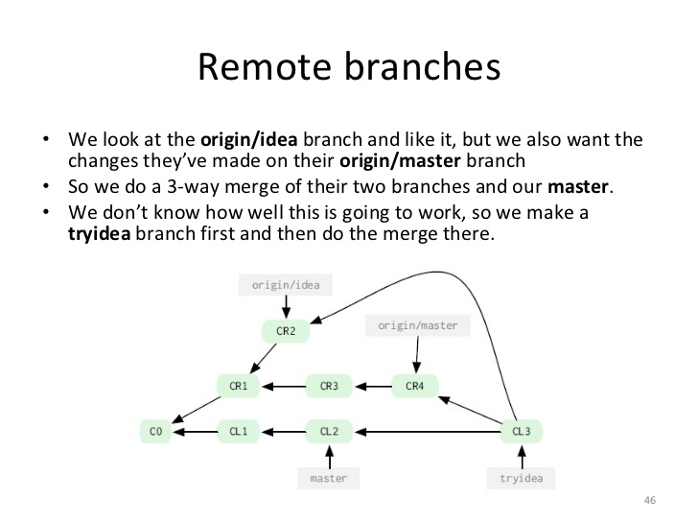
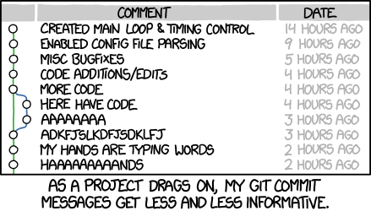
My Summer so far
First Week – Getting used to version control with Git and GitHub.

Slide 4
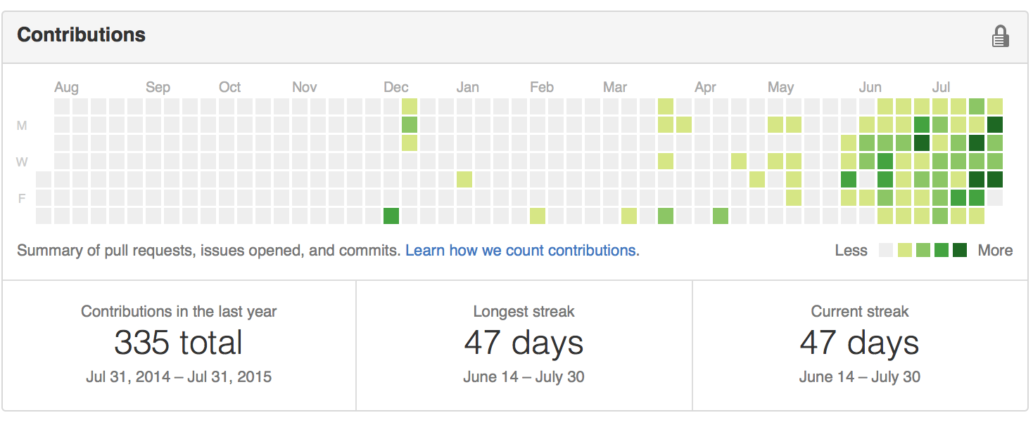
Git – The know it all
“I know what you did this summer“ - Git

Slide 5
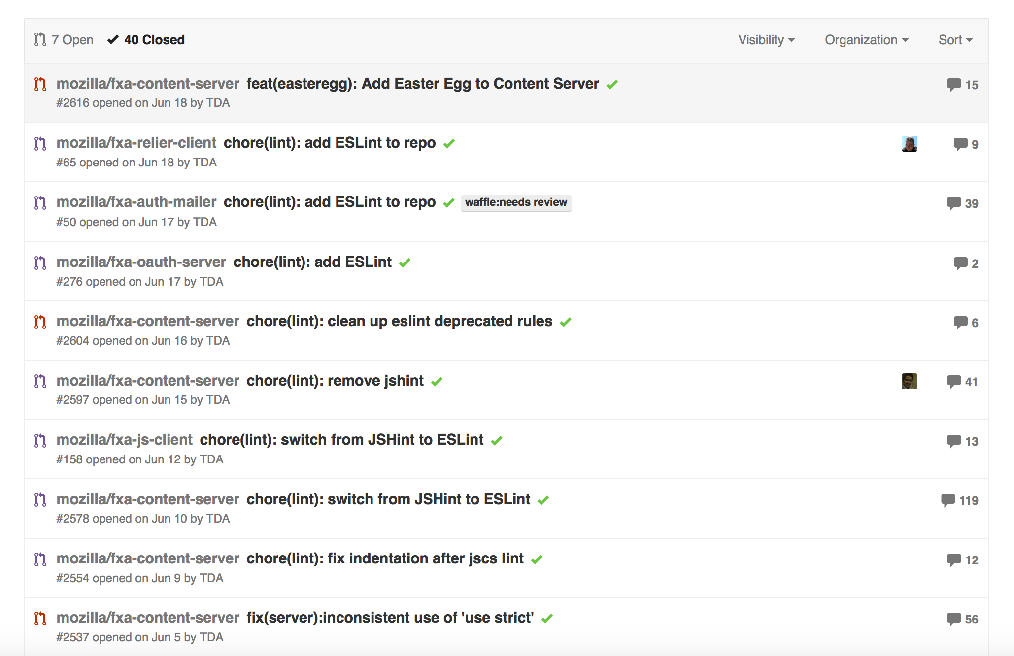
So how did my Summer go?
I worked on a bunch of bug fixes, mostly related to build stuff like Grunt and linting / linters (jshint, eslint and jscs). → See what I did there?

Slide 6
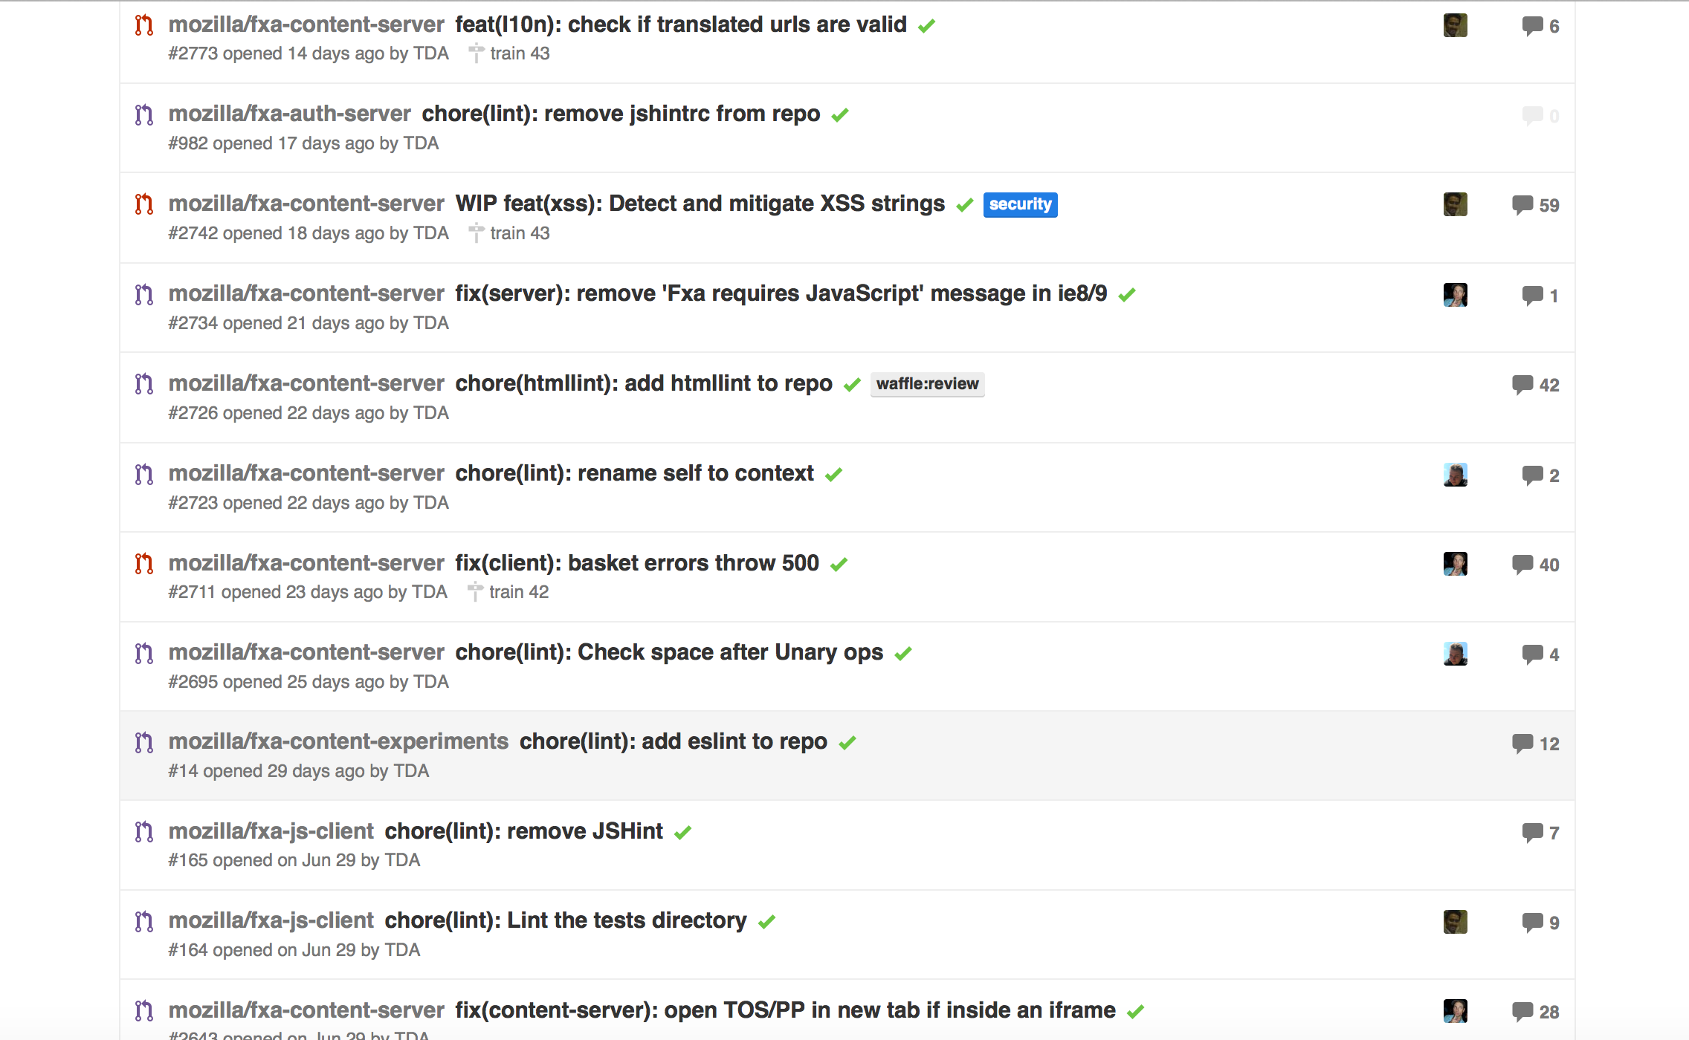
Well.. And?
I also worked on front-end bugs like Internet Explorer 8/9 compatibility stuff. – Yeah, real cool, I know. Don’t be jealous.
And some iframe stuff, basket errors and more linting.
We need MOAR LINTING!!!

Slide 7
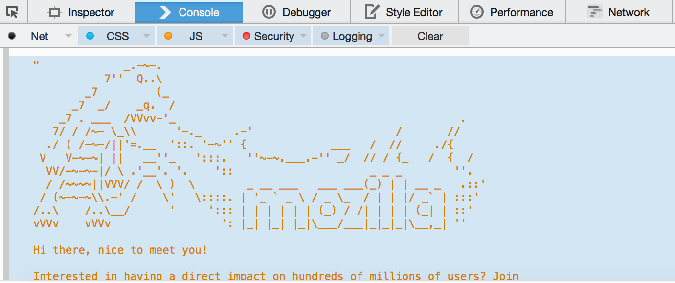
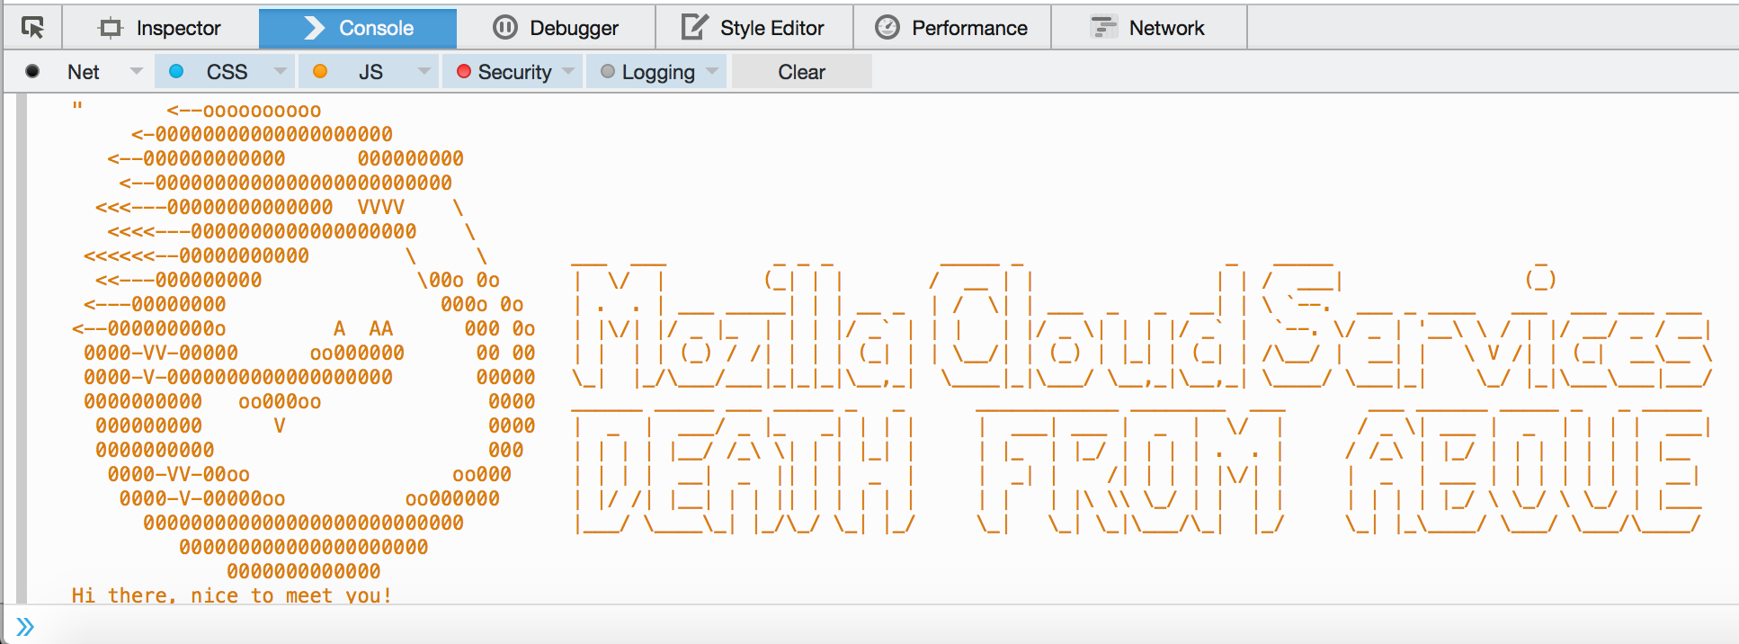
WELL??!?!?!?
Ok, I also added a sweet looking easter egg to the console in the Firefox Accounts page. (Could have been the one on right, if not for that pesky review man.)
Pic Courtesy : jgruen

Slide 8
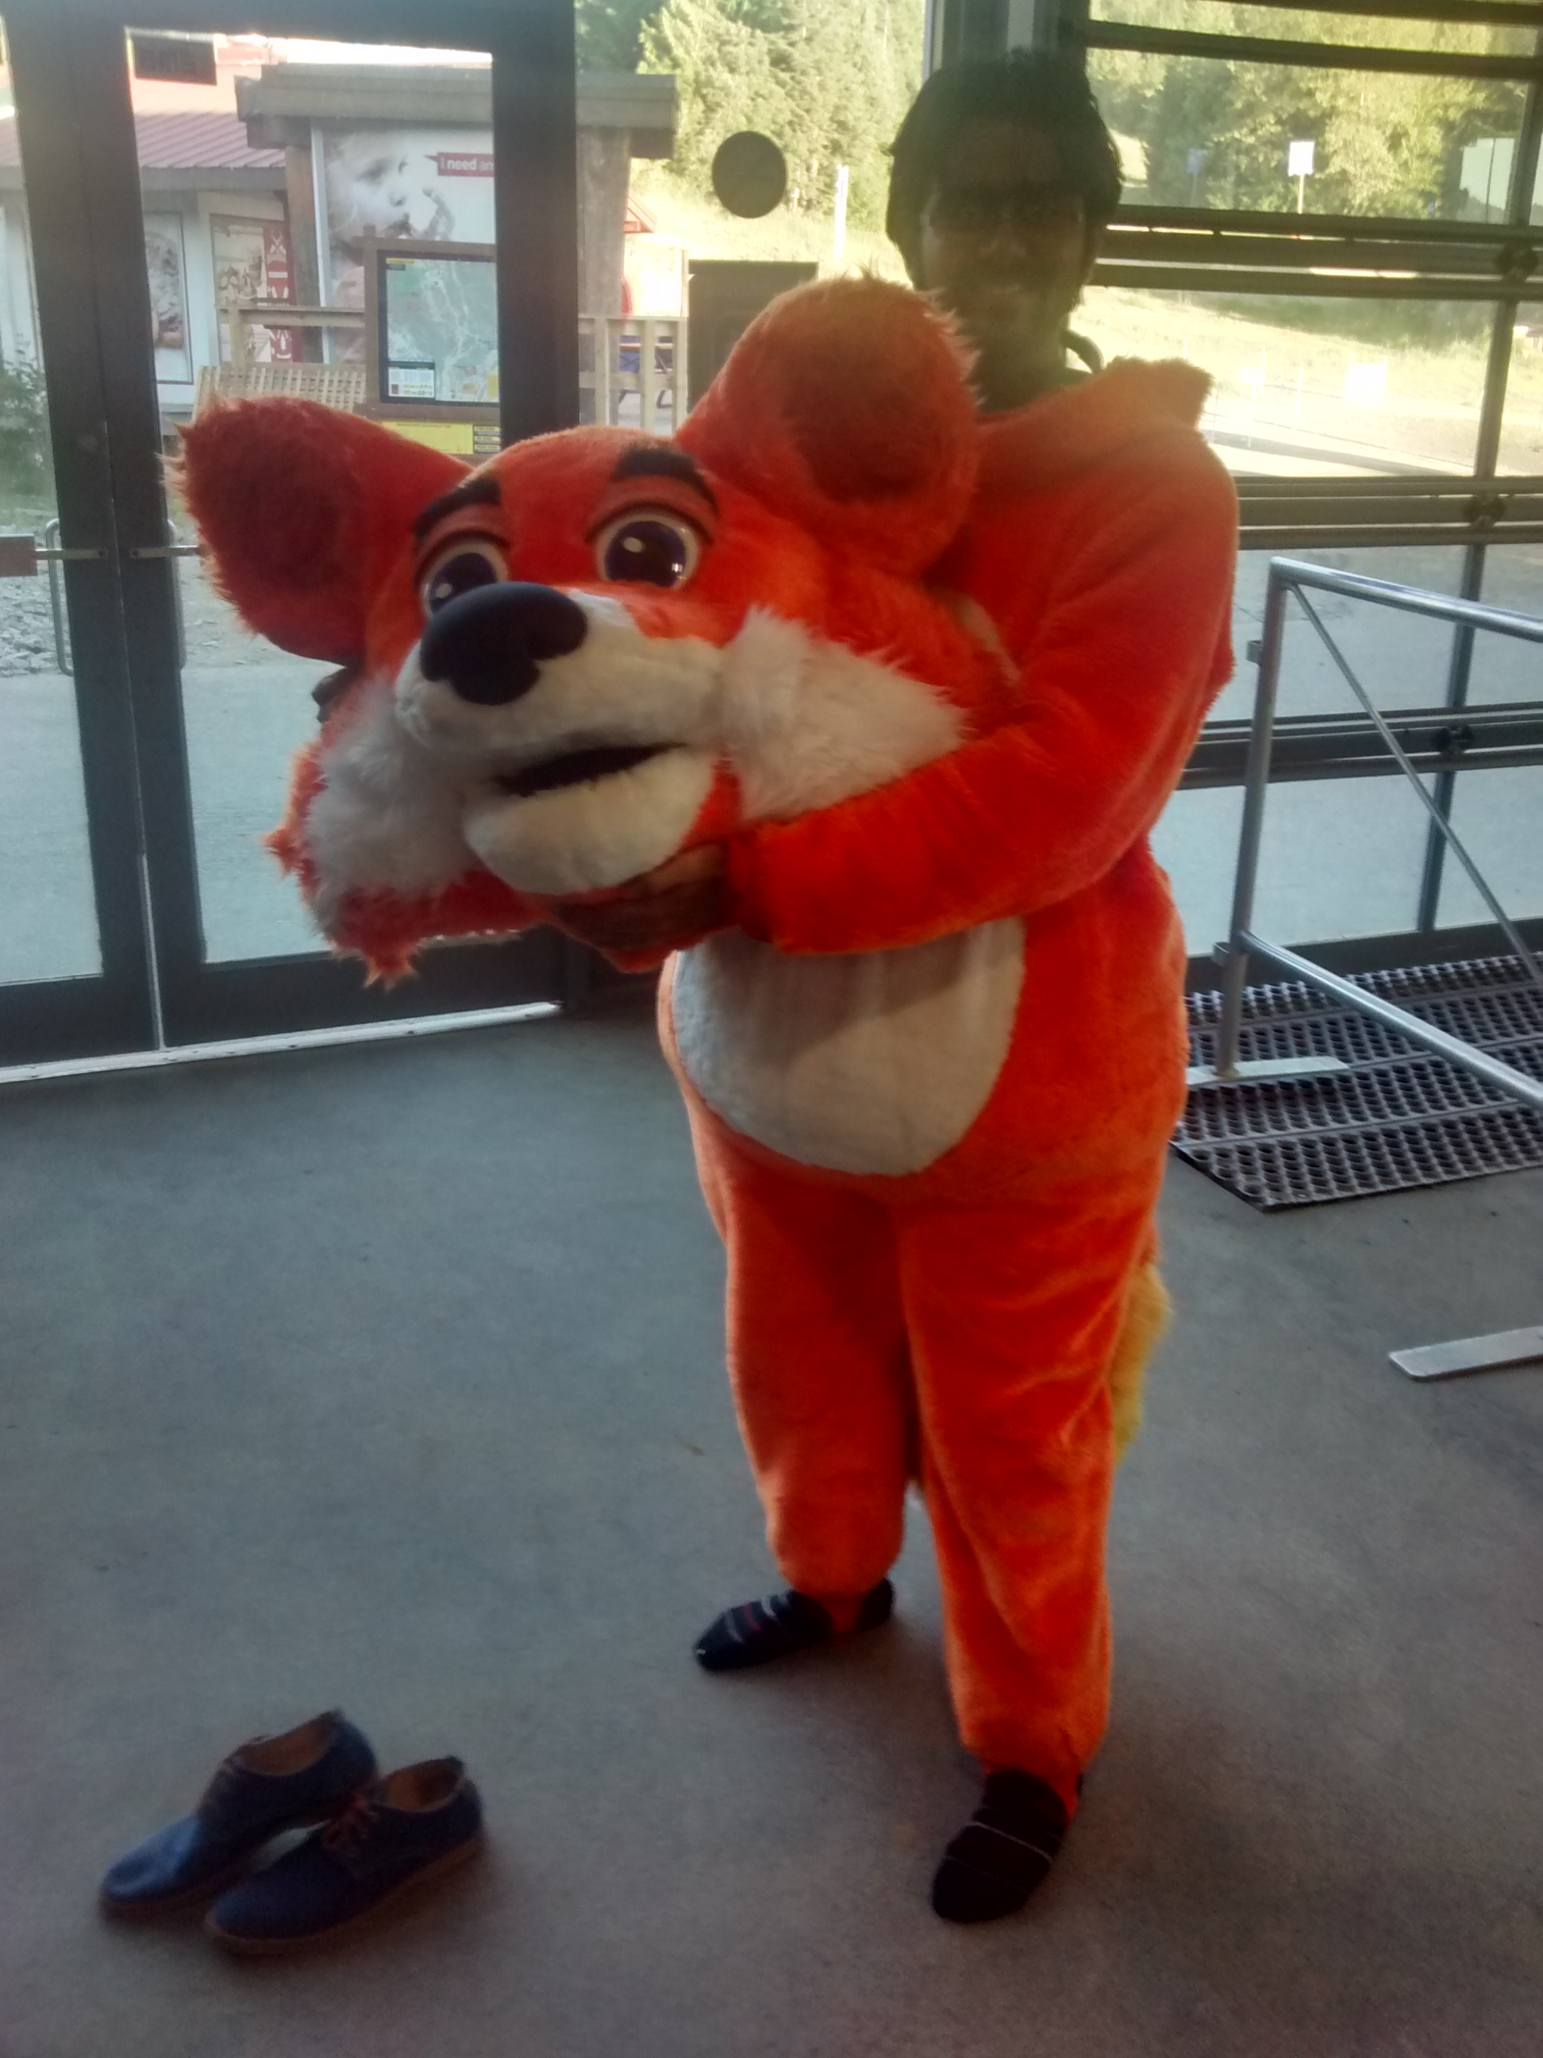
Really? THAT was all you did this summer?
You mean cool stuff? Like this?:

Slide 9
Get out, your wasting our time.
You’re. Grammar Nazi. Sorry.
But all jokes aside, I worked on 3 really nice projects this Summer:
Two-Factor Authentication system for Firefox Accounts
A Password Strength Checker for Firefox Accounts
A tool to check for and remove malicious code from FxA content-server pages, and l10n translations therein. Politically correct much, rfkelly? ;)

Slide 10
FxA - Password Strength Checker
Motivation:
People usually use easy-to-remember passwords, and this results in easy cracking.
We hear of passwords getting stolen, accounts getting hacked, and so on and so forth every week.
Goal:
Suggest to the user to use a better password, that is not easily bruteforced.

Slide 11
The Pledge
Detect short passwords, remember, the shorter the password, the easier to brute force.
Detect whether the user’s password is all numbers/alphabets.
Store a list of common passwords, passwords that are known to be already leaked from other popular services, and cross-verify with this list. → You are joking right? There could be millions of passwords that belong to this category.

Slide 12
The Turn
Right. There were 64 million passwords.
We used a pseudo-free-to-use database of leaked passwords, weak passwords, and obtained a list of 64 mill passwords. [1]
Storing them would probably mean just a bit over 800MB.
Yeah. MB. For a client side strength checker list.
I chose to ignore passwords that were less than 8 characters long → Down to ~5+ Mill.
I then combed through these with my trusted buddy Python, to separate out these into categories of ‘Regexes’.
I ended up with 2 regexes that eliminated almost 98% of these passwords. → Down to 50,000 passwords, still weighing in at a hefty ~5,500 Kilo grams Bytes.
[1] https://crackstation.net/buy-crackstation-wordlist-password-cracking-dictionary.htm

Slide 13
The Prestige
Ha! Was waiting to use that one :P
Bloom Filters to the rescue!!!
So I ended up using a bloom filter to store the passwords, instead of storing them in Plaintext.
A bloom filter stores only a hash of the actual password, and excels in look up, with blazing fast speeds to check if a password is in the filter.
Well, kind of.
A very good write up on the subject can be found at https://www.jasondavies.com/bloomfilter/ → We used his implementation of a bloomfilter with the Fowler–Noll–Vo Hashing technique.

Slide 14
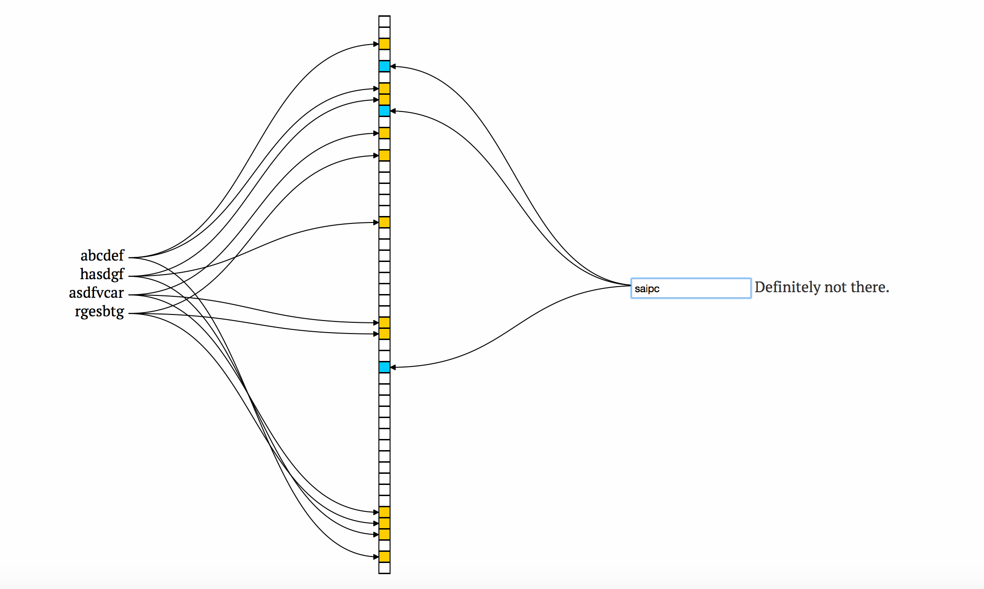
The bit vector trick

Slide 15
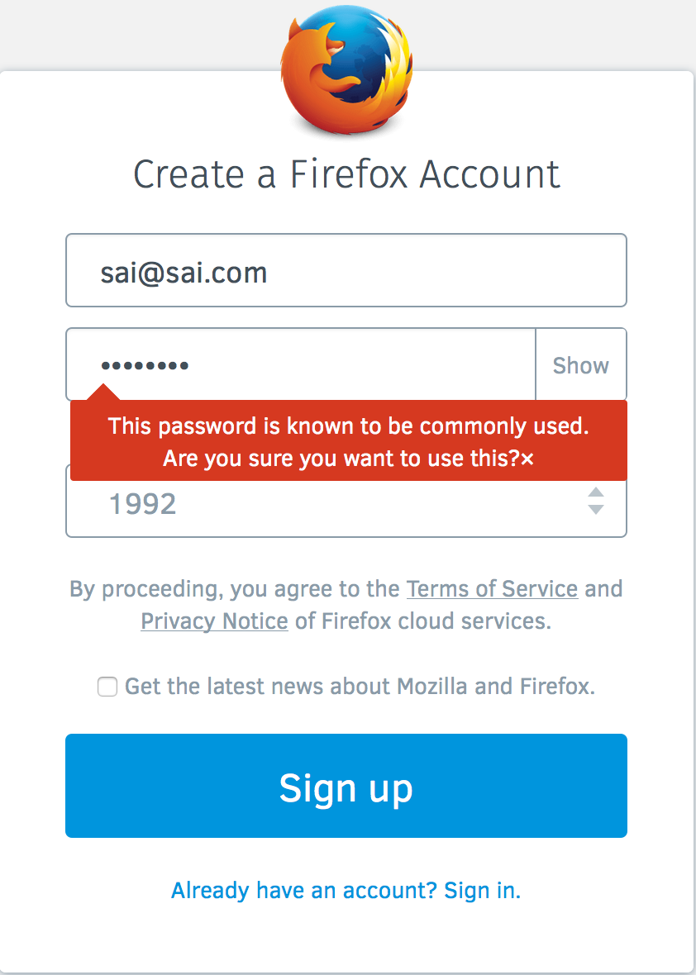
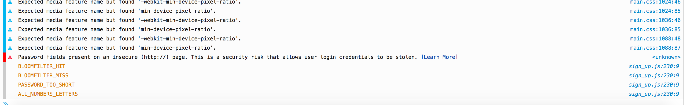
Results
The Password Strength Checker is ready to ship. We are currently only collecting metrics, but a future version can/will include a tooltip (just vary the callback provided).
It can be found at
https://github.com/mozilla/fxa-password-strength-checker
Or if you want to play around with values:
https://github.com/TDA/bloomFilter

Slide 16
FxA – Tool to verify HTML/CSS
Motivation:
FxA uses a lot of html, css and l10n translations in the content-server, and as part of emails to users.
HTML/CSS always provides an attack vector to be exploited, to do things ranging from the innocuous to the deadly.
Goal:
Make sure that all HTML uses valid syntax.
Maintain and impose a whitelist on the tags and attributes allowed.
Make sure that our translators are only using valid urls and not changing the urls we provide. Aka. Whitelist urls
Make sure that the style attribute is not misused, and has valid rules.
In one umbrella term, “Make sure our pages aren’t susceptible to XSS or other vulnerabilities.”

Slide 17
One step at a time
Make sure the HTML is valid:
Regexes – They suck. Why?
HTML Gumbo Parser – Reasonable, but reinventing the wheel. Why?
The xss module – (Gumbo + regexes) on steroids. Terrible Idea? Not really!
Allows us to maintain a whitelist of allowed tags and attributes for those tags.
Allows us to remove/modify anything that doesn’t belong to the whitelist.
So, “Reparo!”.

Slide 18
Make sure the URLS are legit:
Cause for concern: Vlad proclaiming that someone might change our URLS to bing.com. (That was the most evil thing he could think of)
I wrote a Grunt task to grab the server.pot file, use a po2json convertor script on that, run through the JSON key-values, and then grab the URLS.
With this set of legit URLS, I wrote another Grunt task, which ran on the generated/translated files, and flagged anything that wasn’t in the set of legit URLS.

Slide 19
Findings:
As if to prove Vlad’s concern, we found that Firefox China had its OWN implementation of the content-server, and had modified some URLS to point to their locally hosted content-server, rather than use ours.
Think for a minute. Breathe. Think again.
http://firefox.com.cn/ and http://mozilla.com.cn/moz-portal.html are modified to ‘suit’ the Chinese audience, complete with a blog, ads, and a QR Code to install WeChat. Yup, you read that right.

Slide 20
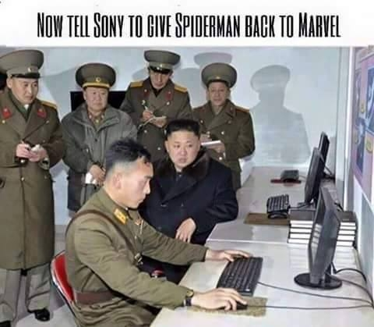
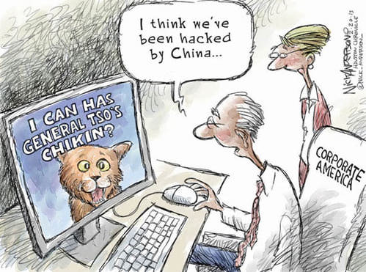
Disclaimer: I know one of them is not a China meme, but hey, its funny. Kinda.

Slide 21
Make sure the styles are legit
I used a very similar approach to extracting the URLs (previous slide, already forgotten??), with slight modifications to extract, and check for the presence of allowed styles.
Combined with the xss module checking for whitelisted CSS attributes, this is pretty robust.

Slide 22
And that brings us to.. *drumroll*
Two-Factor Authentication for Firefox Accounts
Motivation
Highly awaited feature.
I have worked on multi-factor before, with Facial Recognition and Passwords.
My mentor loves this idea.
What more do you want? Really?

Slide 23
Caveats
Adding two-factor authentication to the signup flow needs lots and lots of user-testing.
And work. Lots of work, from a lot of people from different parts of the team.
Using SMS as a second-factor needs monetary investment. A lot of investment.
Tl;dr: All these put together would result in a project that is much longer than my internship period.

Slide 24
So, we settled for:
Setting up the 2-Factor options inside the settings page.
Using Google Authenticator as the second-factor, and implementing the TOTP algorithm.
Laying out the framework/infrastructure for expanding the two-factor auth system to include other forms of authentication.
Most importantly, learning what is needed to make this project a success.

Slide 25
So, how far along are we?
Pretty far. In fact, I have a working demo of setting up a 2-factor on FxA. Sadly, It does nothing on the backend yet though.
You can check this out at:
https://github.com/TDA/fxa-two-factor-auth - Integrated (incompletely), with FxA.
https://github.com/TDA/2fa - A more customizable, stand-alone module/demo for 2fa.

Slide 26
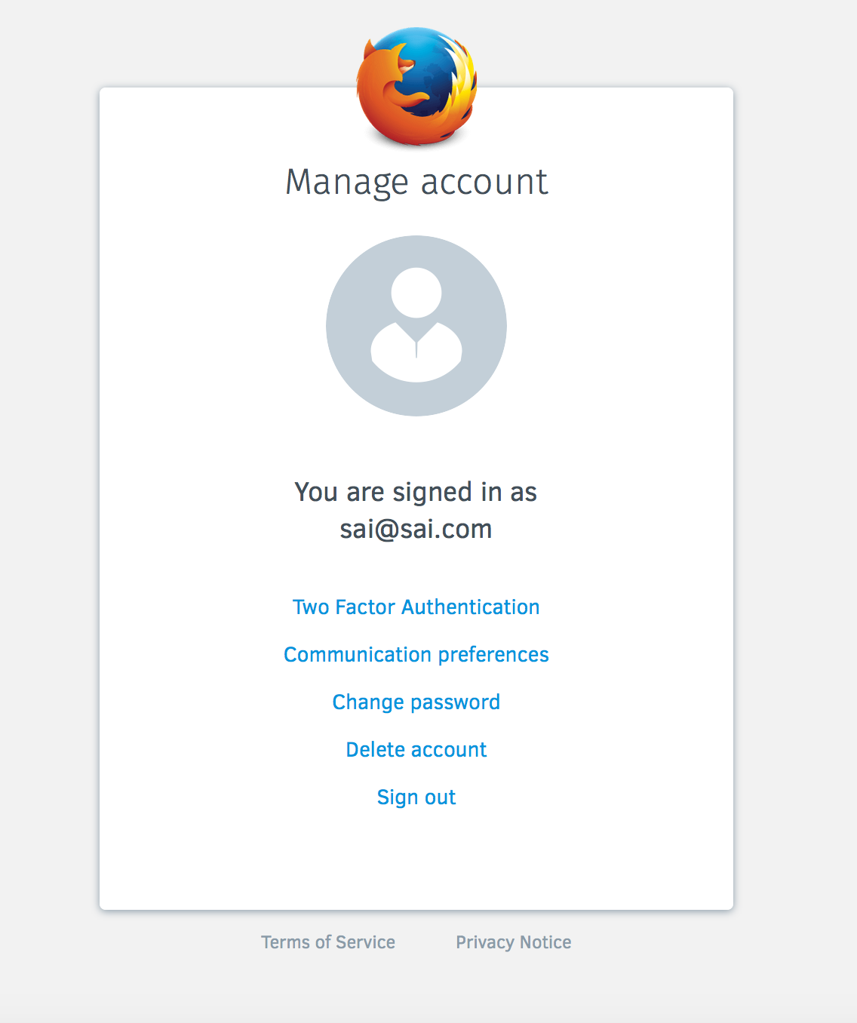
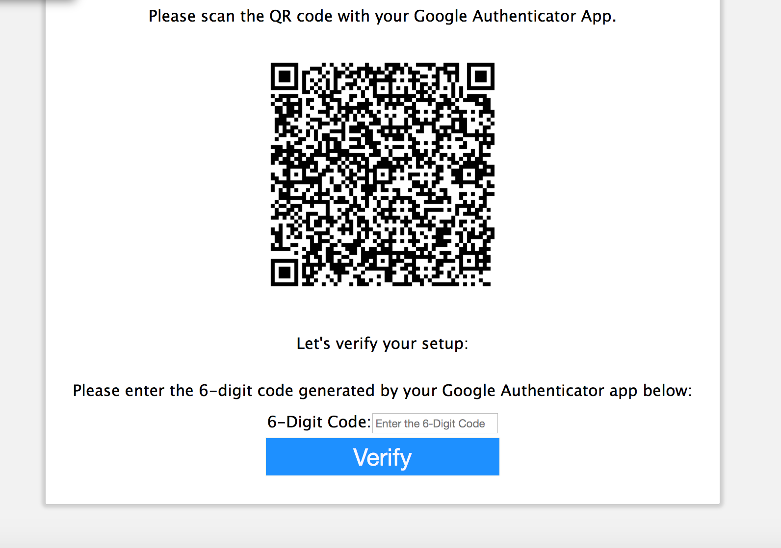
Screens for Two-Factor Authentication
Ignore the badly sized screens

Slide 27
Findings
We learned a lot from this Project, and most of those are documented in the following document:
https://github.com/TDA/2fa/blob/master/Software%20Requirements%20Specification%20-%202FA.docx

Slide 28
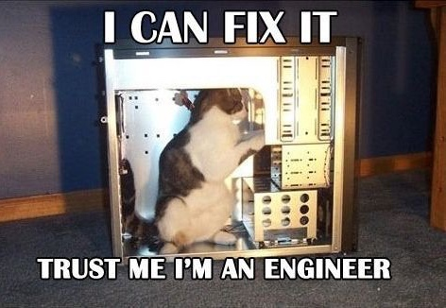
Colophon
The font used on the slides in general is Corbel(Body). The headings are Corbel(Headings). The slides are a default preset from MS Powerpoint.
The font used on this page is Comic Sans MS(aka most hated font of all times), just to irritate anyone who has an aversion to it. Trust me, I am a web developer.

Slide 29
Thanks to..
The University Recruiting team – Misty, Kyle, Ivadell and Jill.
(Seriously guys, get someone with a name starting with ‘L’, then it can be IJKLM)

Slide 30
Thanks to..
The Cloud Services Team:
Chris Karlof (ckarlof) – For all the support and advice (and dinners).
Ryan Kelly (rfkelly) – For the password checker project.
Edwin Wong (edwong) – For all the support and SFO details.
John Morrison (jrgm) – For all the support and meetings.
Ryan Feeley (rfeeley) – For all the UX guidance.
John Gruen (jgruen) – For the extremely cool logos (and css help).
Daniel Coates (dcoates) – For helping me in Whistler.
Phil Booth (pb) – For that awesome accent.
Edouard Oger (eoger) – For making 2 million PR’s a day and keeping me on my toes.

Slide 31
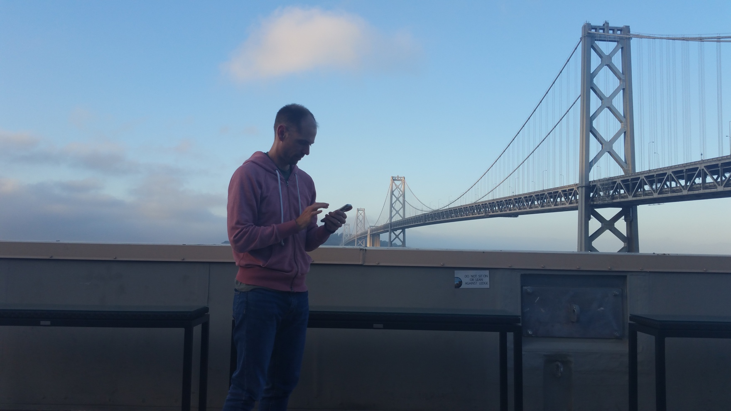
Special Thanks to..
Shane Tomlinson (stomlinson) – My Mentor and Guide
For being patient with me, and helping me out everyday, and almost everything else this summer ☺ Thanks for all the sacrifice, Shane!!!

Slide 32
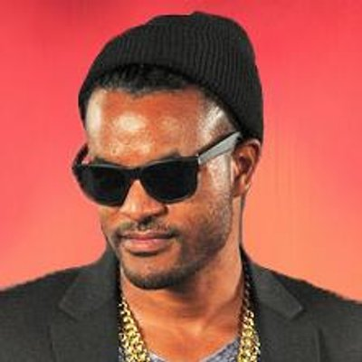
And..
Zach Carter (zaach) – My Local Mentor
Swag!
Starting from helping me set up my MacBook for development, to helping me with a dozen bugs over the next few weeks. Thank you so much Zach! ☺

Slide 33
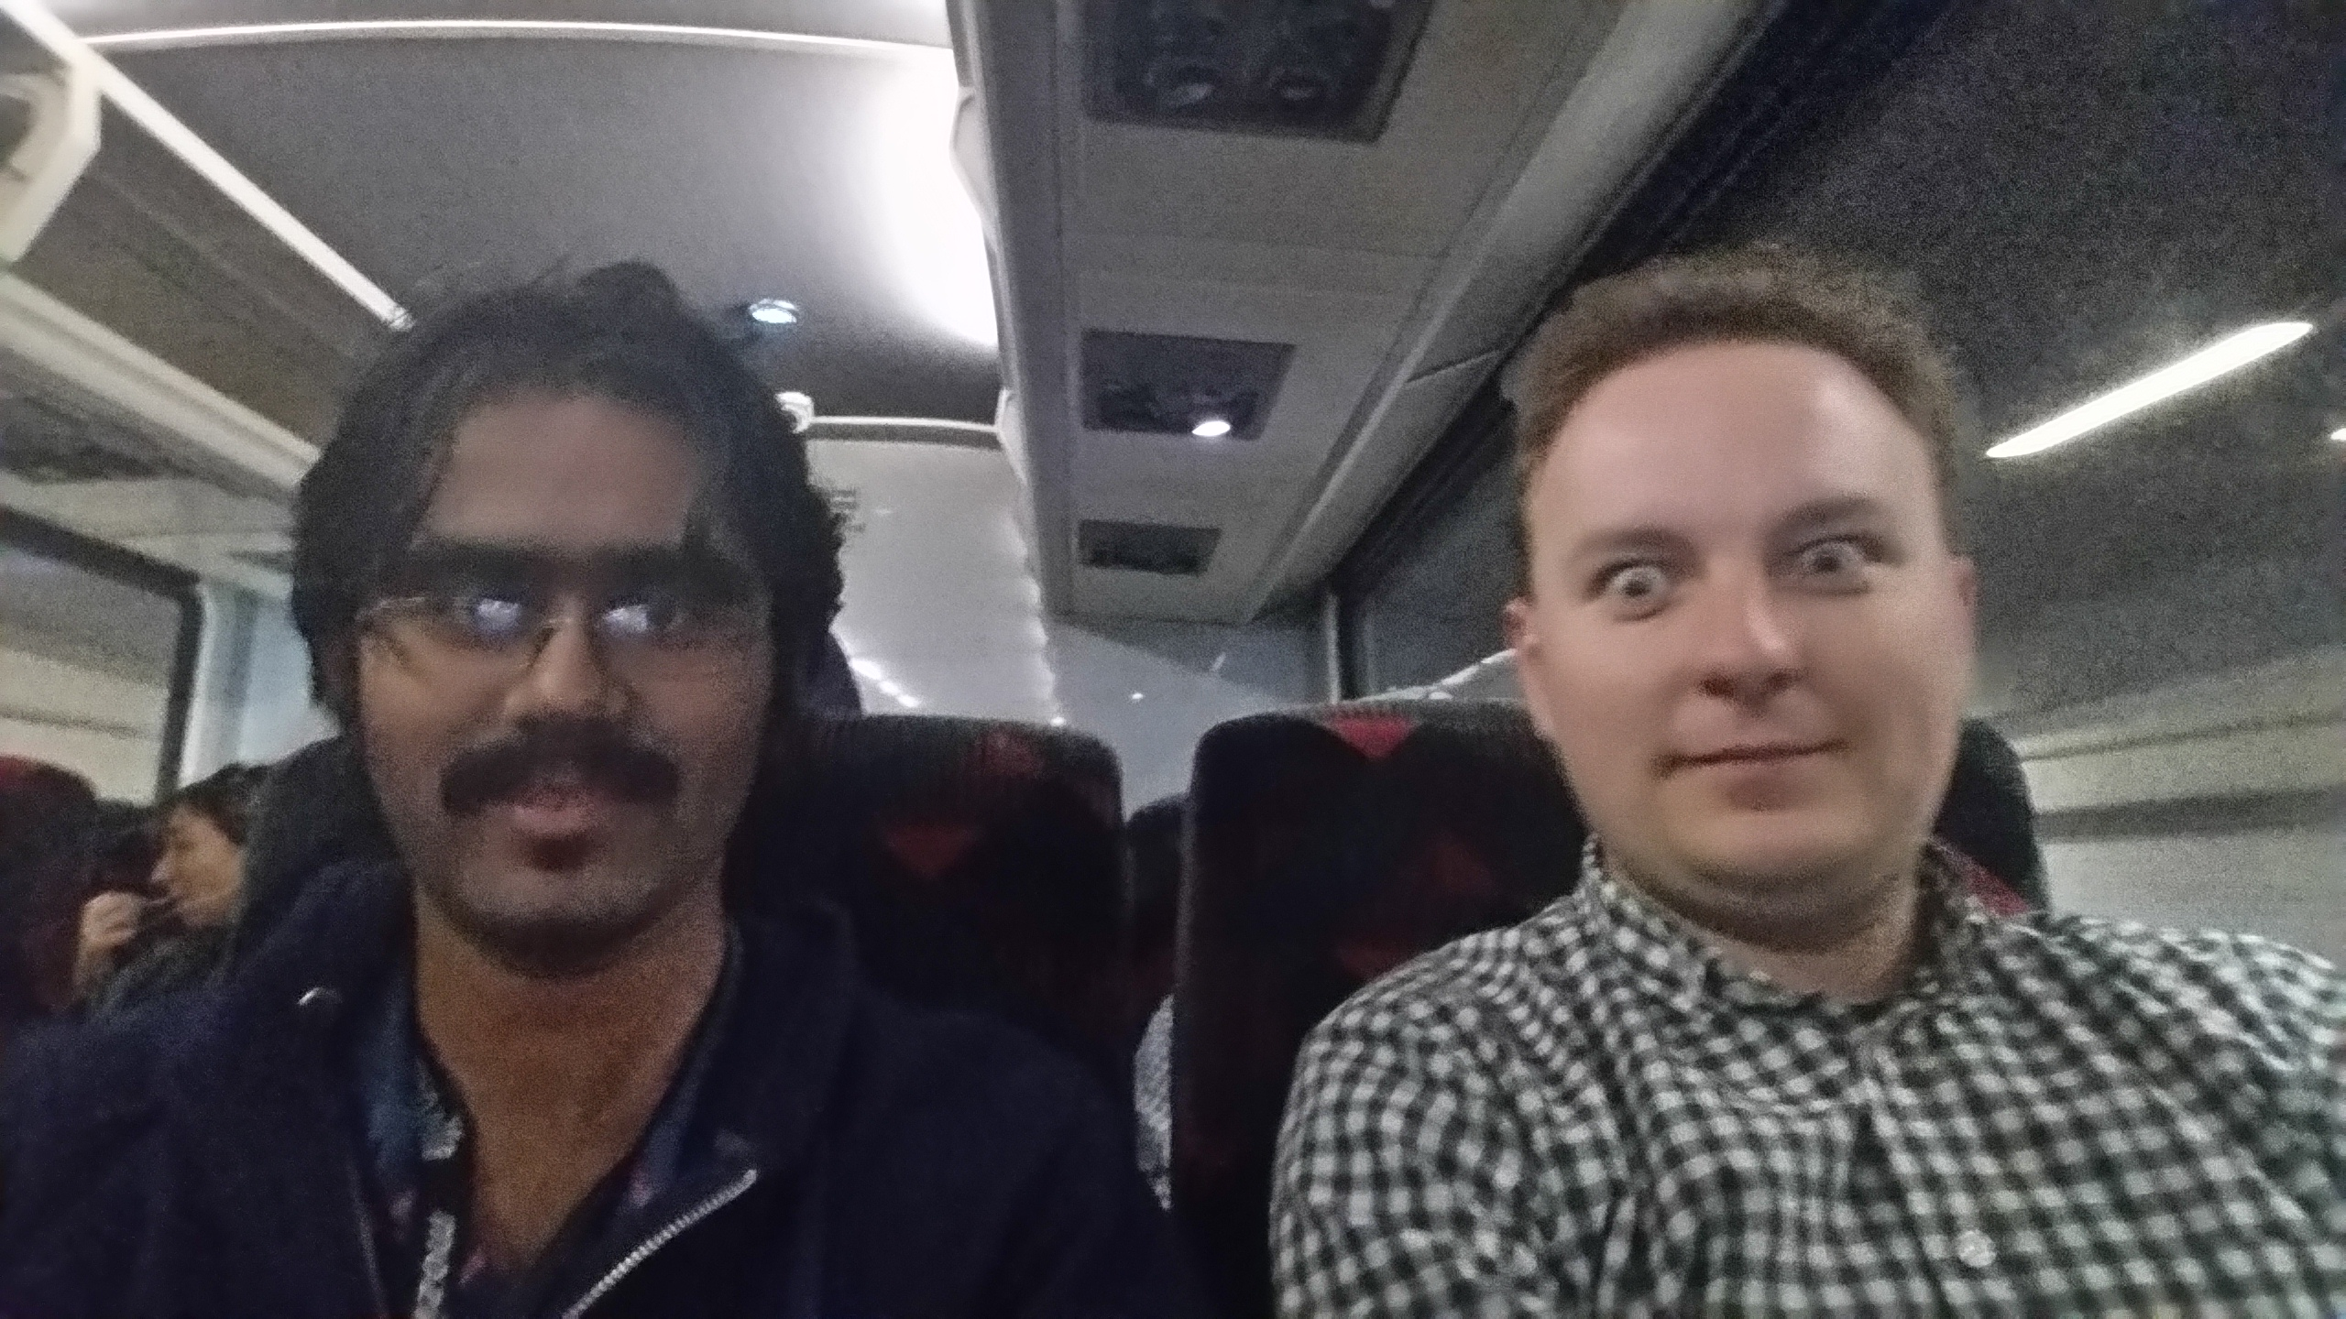
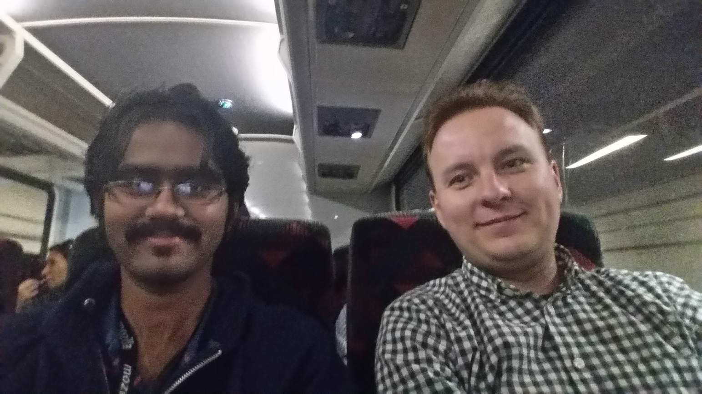
And..
Vlad Filippov (vladikoff) – The Review man.
For the countless reviews and feedback on every push ever made. Thank you so much Vlad! ☺

Slide 34

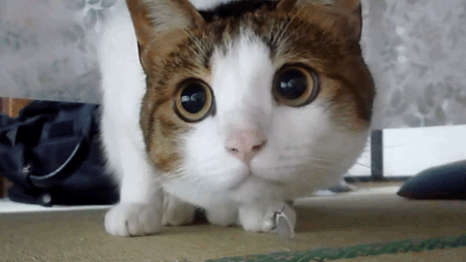
And Finallllly….
Peter Dehaan (pdehaan) – The funniest SW engineer I have met.
NOTHING EVER GETS PAST ME!!! MUHAHAHAHAHAHA!!!
Will you teach me sensei?
Peter was literally the person I ran to, every time I got stuck on ANYTHING, with the kitty face on the right. He put up with my ramblings and rants, and got me the absolute best gifs ever!! Thank you so much Peter, for finding the time to make people laugh ☺

Slide 35
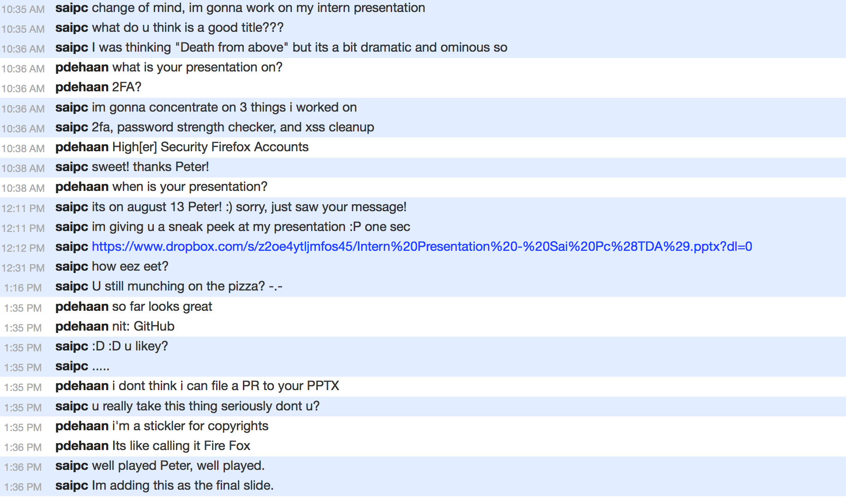
Had to add this T_T
This is why we can’t have good things in life.

